Slide 1
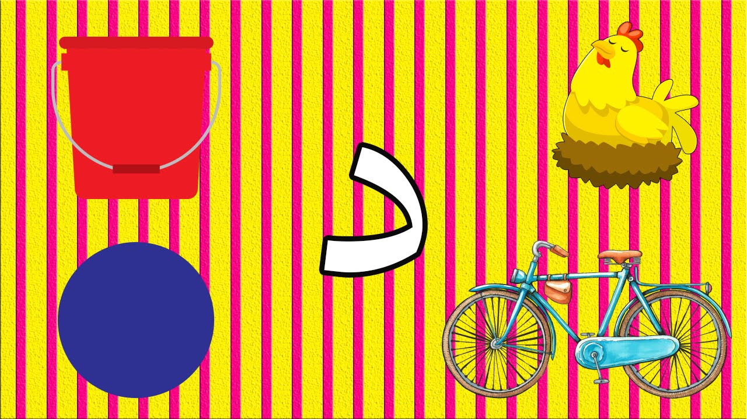
حرف الدال

Slide 2
الدرس الثامن- حرف د
لنبدأ بمشاهدة الأبجدية
Lets start by watching the alphabet:
https://www.youtube.com/watch?v=5yO433hdR2M
الاغاني فيها حرف د
Songs with the letter د
https://www.youtube.com/watch?v=DV8yPqAhF44
https://www.youtube.com/watch?v=3qoqyce2RHg

Slide 3
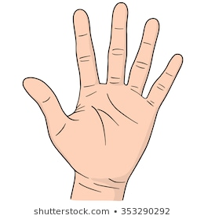
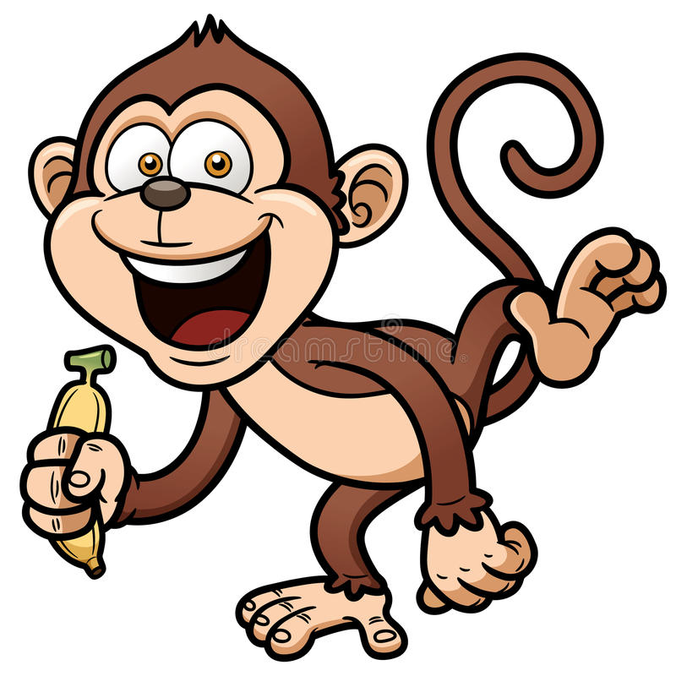
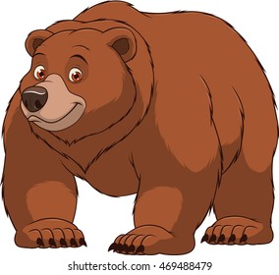
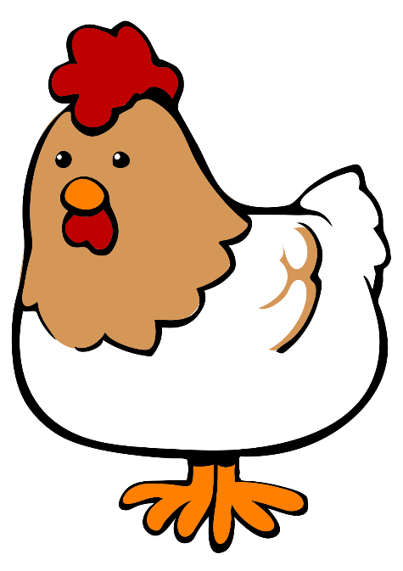
كيف نكتب حرف د How we write حرف د
قِ ر د
ي د
دُ ب
د ج ا ج ة
م د رس ة

Slide 4
Complete pages 75-82 of your exercise books

Slide 5
Homework واجب البيتي due
Complete any previous work which is incomplete
Complete pages 31-32 of your handwriting books

