Slide 1
حرف الباء

Slide 2
الدرس الثاني : حرف ب
Lets watch the alphabet to refresh our minds.
https://www.youtube.com/watch?v=5yO433hdR2M
Now lets watch a video for حرف ب:
https://www.youtube.com/watch?v=FNT1gvhITdE

Slide 3
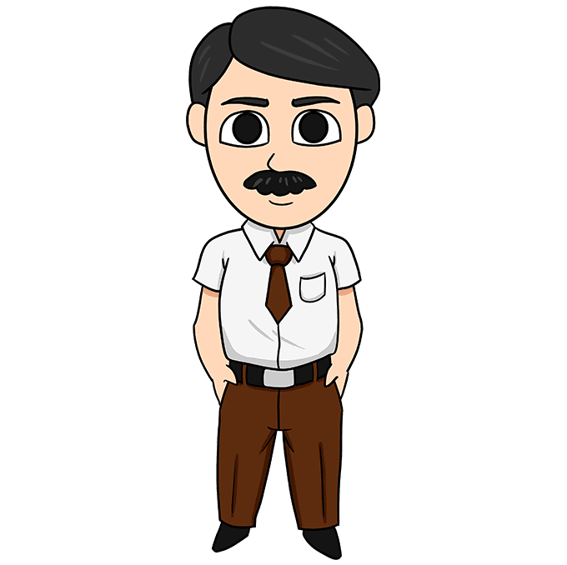
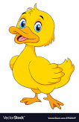
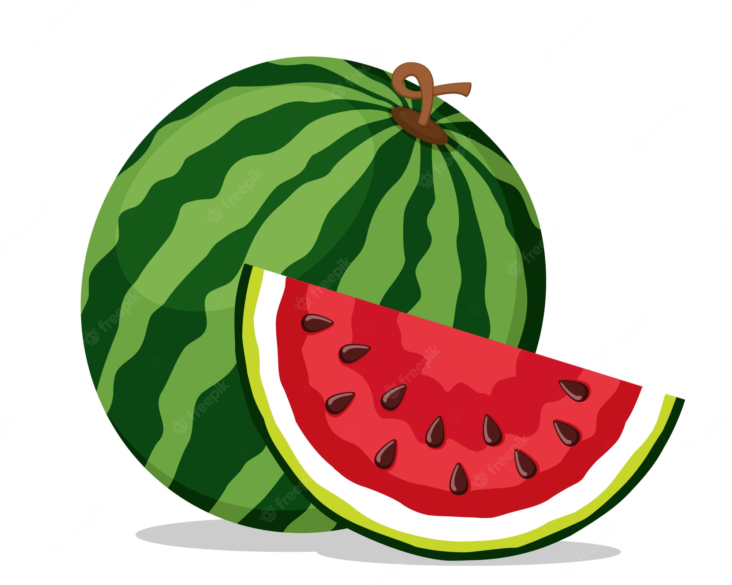
Words that have the letter ب
بط بابا
بطيخ باب

Slide 4
Homework! واجب البيتي
Worksheets given & on school website
Here is a fun video to sum up the lesson today!!
https://www.youtube.com/watch?v=Hbm65r3woo0

