Slide 1
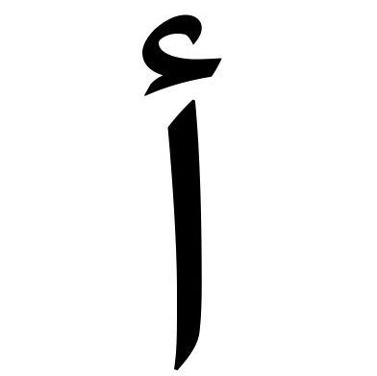
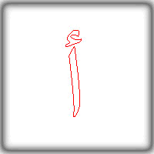
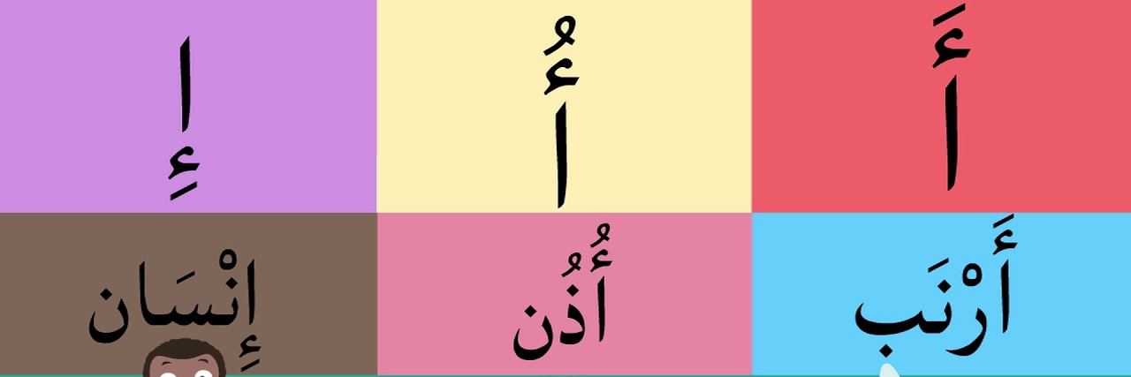
حرف الالف

Slide 2
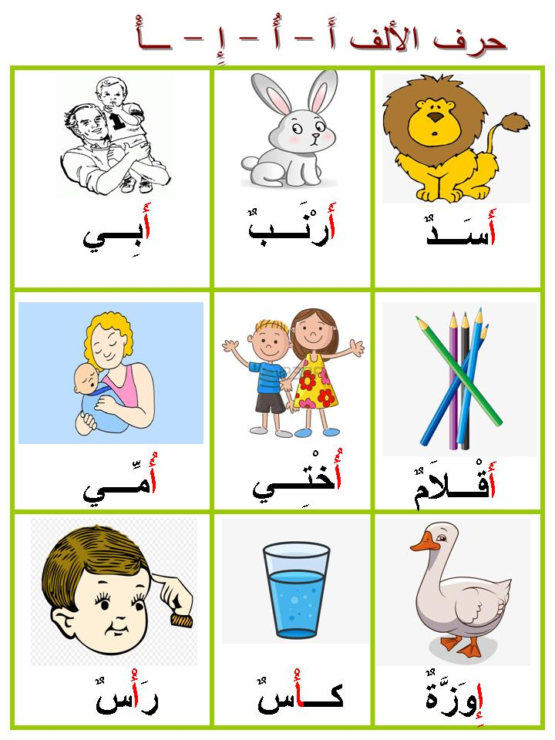
Welcome to your first lesson!
how well do you remember the arabic alphabet?
https://www.youtube.com/watch?v=5yO433hdR2M
Now that you’ve hopefully remembered the alphabet, lets move on to the first letter of this week.

Slide 3
اتعلم ان حرف أ هو واحد من الحروف المنفصلة
كيف نكتب الحرف أ:
اول الكلمة : أ... أسد
وسط الكلمة : ـا ... فأر
وفي اخر الكلمة : ـأ... عصا
We know that the letter أ is one of the letters that cannot be joined to the left. Why is this?
We now introduce naughty letters!!
Naughty letters are letters that do not join to the left. What letters can you think of that have the same rule?
Naughty letters in the Arabic alphabet:
و ز ر ذ د ا

Slide 4
أرنب باب كِتاب
أسد

