Slide 1
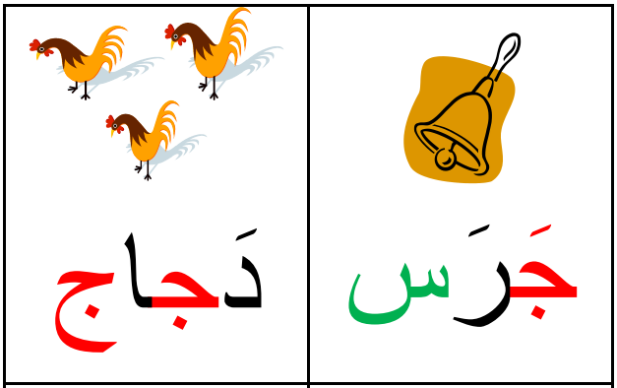
حرف الجيم

Slide 2
الدرس الخامس - حرف ج
Lets see who can recall the alphabet on their own? If you need any help click the video below:
https://www.youtube.com/watch?v=5yO433hdR2M
Lets us begin with letter ج:
https://www.youtube.com/watch?v=Vq8jGh1f9Hw
https://www.youtube.com/watch?v=3qoqyce2RHg&feature=youtu.be

Slide 3
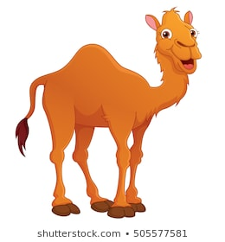
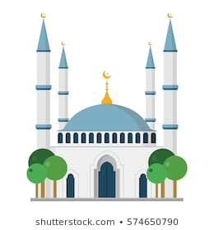
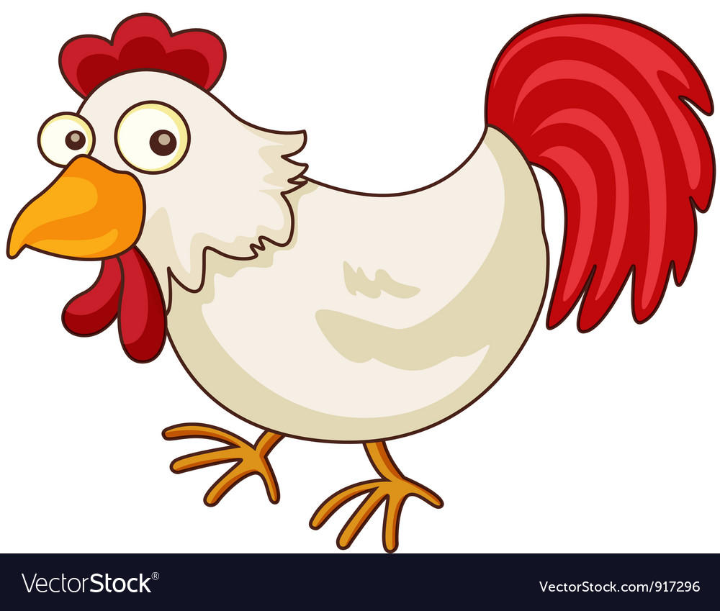
كيف نكتب حرف ج
اول الكلمة: جـ جمل
وسط الكلمة: ـجـ مسجد
اخر الكلمة: ـج دجاج

Slide 4
Please now complete the tasks in your exercise books ☺

Slide 5
Homework واجب البيتي
Finish off all your book exercises

